Slide 1

Find Your Dublin
Group 1 MSc Team Project

Slide 2
This week goal: Maximise visualisation
1
Added dynamic map visualisation for universities and famous attractions on home page
2
Made detailed how it works page
3
Changed questionnaire layout and updated background
4
Added amenities data to journey planner map with subsections like lidl, tesco, spar, aldi, etc

Slide 3
Next Week: Public Transport Integration
Bus Network Integration
1
Collect Dublin Bus and Go Ahead Ireland routes, stops, schedules and connections data
Rail and Luas Network
2
Collect station locations, routes, stops, timetables and service connections data
Leap Card & Fare Information
3
Investigate different Leap Card options, fare, daily and weekly caps, 90 minute fares, ticket plans and eligibility conditions
Transport Apps & Travel Regulations
4
Explore travel apps like TFI Live, TFI Leap card and review rules and regulations

Slide 4
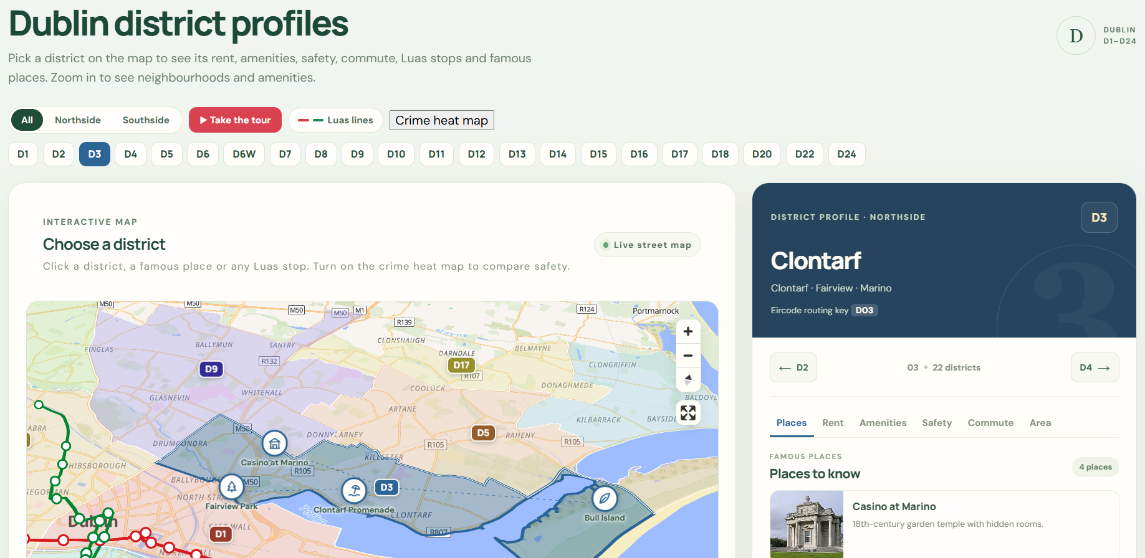
District profiles, from map to recommendation
An interactive profile for every Dublin district, D1–D24, now shown under each recommended area.
Built the district explorer (map and profile card) with the team’s real data.
Added the crime data as a heat map and safety score.
Linked each recommendation to a map of its district.
Deployed it to the live Azure site.

Slide 5
All 24 districts on one interactive map
Crime heat map
Safety score for 255 census areas: where 50 is the Dublin average.
Live street map
Zoom in to see neighbourhood names. Every Luas stop is clickable: line, frequency, nearby amenities.
Six-tab profile card
Places, Rent, Amenities, Safety, Commute and Area for each district, with ← → to step through.
Rent
Daft listings for rooms and whole homes, next to official RTB 2025 averages by area.
Commute
Walking and public transport times to the student’s campus, picked from 15 universities.
Places to know
Famous places pinned on the map with photos, for every district.

Slide 6
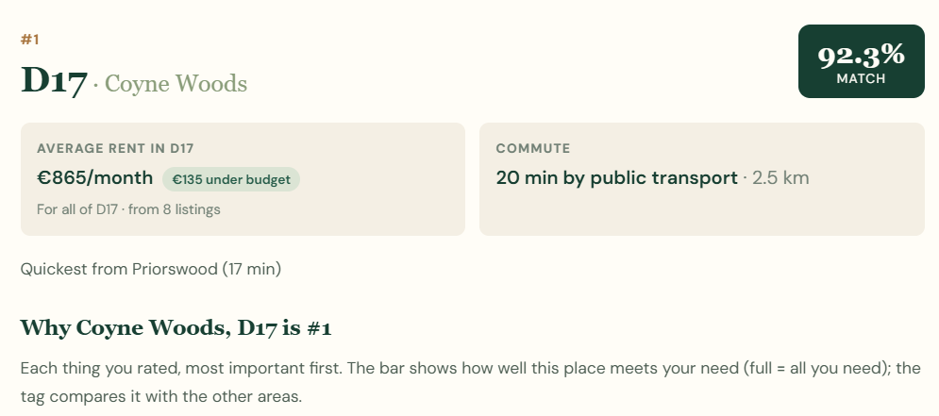
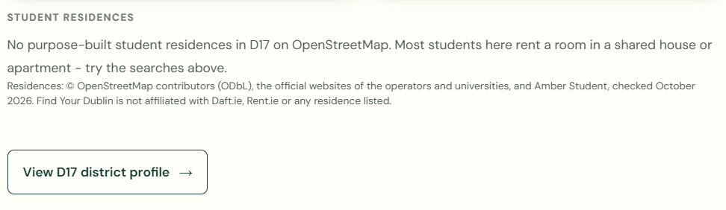
In Progess: A map of each recommended district:
Under every recommendation card:
Zooms to that district only; everything outside is hidden
Safety areas, Luas lines and stops, places to know, neighbourhood names
Commute line from the recommended place to the student’s campus
Option to explore any other district, plus a link to its full profile
Reads each card’s district itself: one component covers D1–D24

Slide 7
Implementations done for this week
Journey planner
1
Safety score
2
Property listings
3
Is the data legal to use?
4

Slide 8
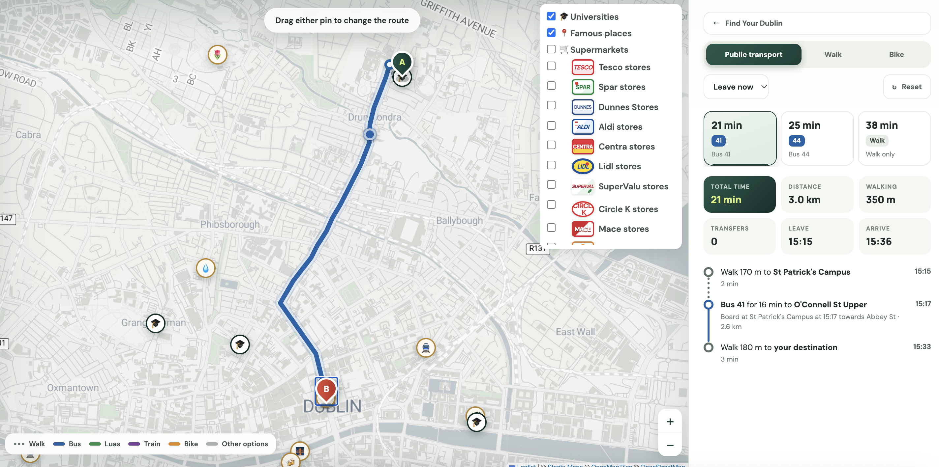
How we calculate travel times?
1
You choose
where from, where to, and when, e.g. leave at 8:30 or arrive by 9:00
2
It checks the timetable
finds the buses, Luas and trains that actually run at that time
3
It shows the fastest ways
up to 3 options, with the walking, waiting and changes
Why not Google Maps API?
Google charges for each search and does not let us keep the results. Our planner uses the same official timetable for free.

Slide 9
How the journey planner works?
Student
phone or laptop
start, end, time
Website
journey planner map
request
Backend
FastAPI on Azure
trip + time
OpenTripPlanner
our server (Azure VM)
route on map
3 journeys
journeys
check first
loaded at start
Cache
same trip in the last 5 minutes?
Data
TFI timetables (every bus, Luas, train) + OpenStreetMap streets

Slide 10
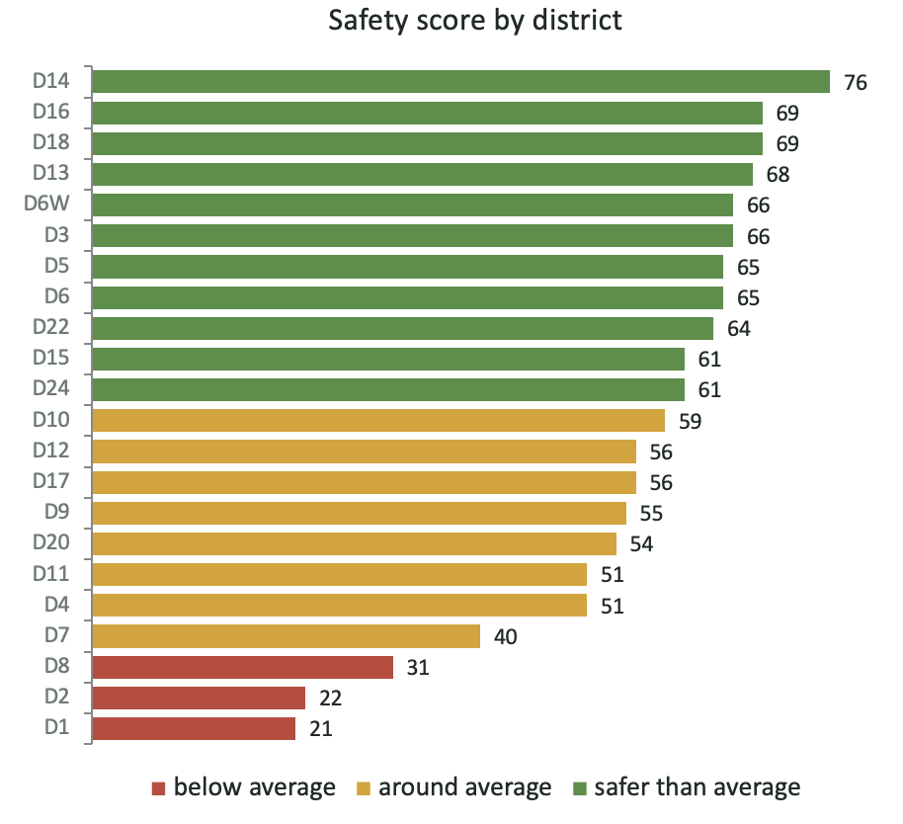
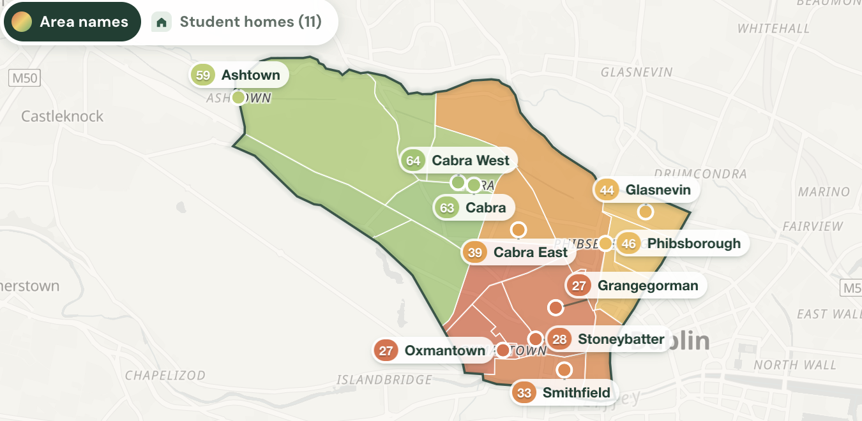
How safe is each area?
A score out of 100 from official Garda crime figures: 50 is the Dublin average, higher is safer
1
Count street crimes
robberies and public order offences, 2023–2025 (Garda figures from the CSO)
2
Allow for how busy it is
busy areas have more people, so we count crimes per person, including daytime visitors
3
Score each small area
every Census area gets its own score, so one district can show safer and less safe parts
4
Show it as a heatmap
each district map is coloured area by area, from red to green

Slide 11
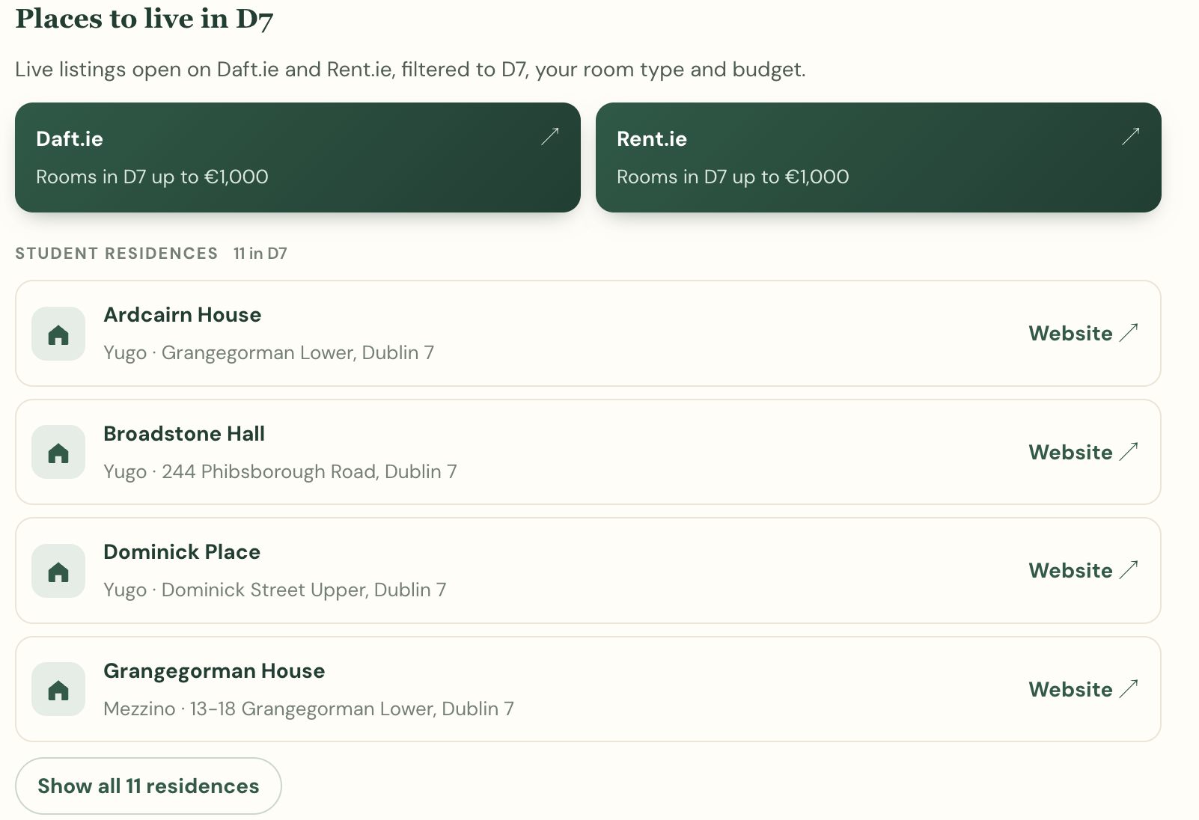
Property listings: where can students live?
1
Rental searches
one click opens Daft.ie or Rent.ie, already filtered to the area, room type and budget
2
Student residences
49 residences, each linked to its own website
3
On the map
switch on “Student homes” to see where they are on the safety map

Slide 12


Is the data legal to use?
Yes. The data is free and official and our links pass on no personal data
Free to use, with credit
Links
Bus, Luas and train timetables (TFI)
Crime figures and Census (CSO)
Rents (RTB, via the CSO)
Street maps (OpenStreetMap)
We name every source on the website
We have added links for daft.ie, rent.ie and student residences.
Under EU law, linking to other websites is legal (EU Court of Justice, Svensson, C-466/12, 2014), and our links carry no personal data under GDPR Article 4(1).

Slide 13


Set up OpenTripPlanner API on an Azure virtual machine:
Uses Transport for Ireland timetables: bus, Luas, DART and rail
Combined with OpenStreetMap to calculate real commute time by walking and cycling.
Pre Calculated the distance and time using OpenTripPlanner API and used in the recommendation system

Slide 14
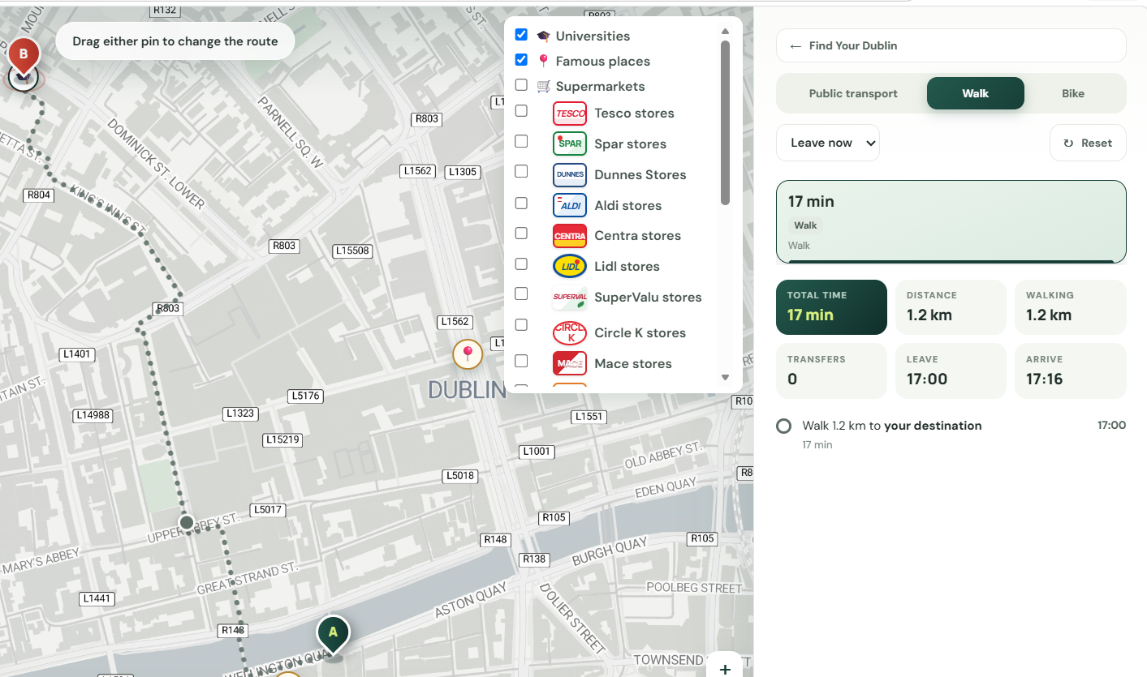
Journey Planner:
Added all 15 universities and famous places across Dublin.
Students can plan a route to or from any marker
The same API is also used to calculate live delays for Journey Planner

Slide 15
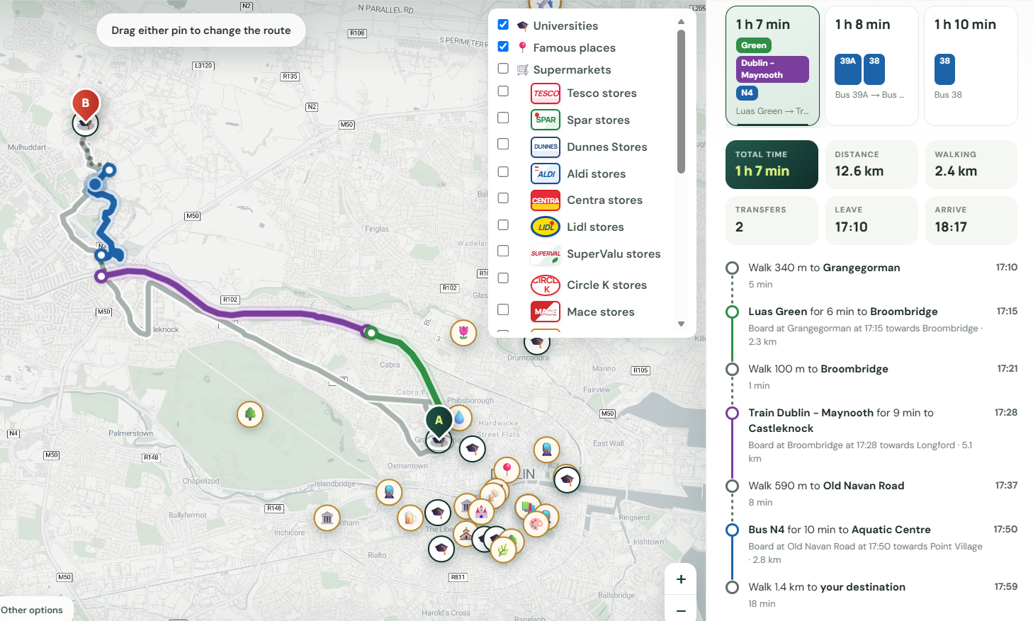
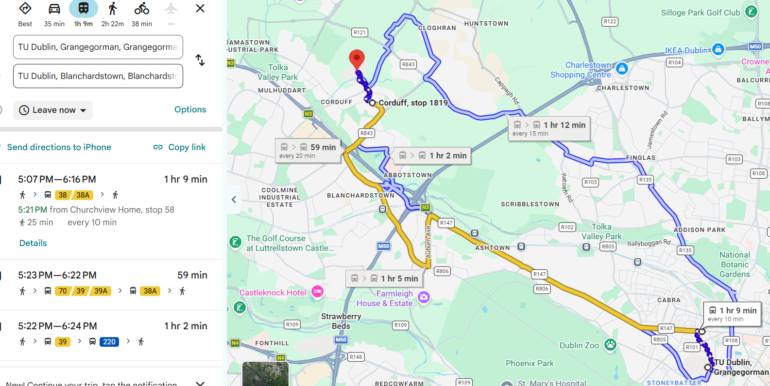
Journey Planner Evaluation:

Slide 16
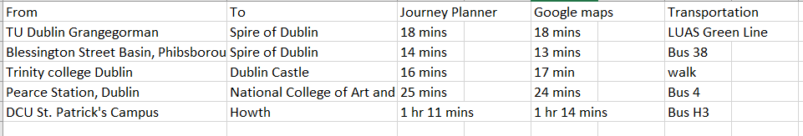
Journey Planner Evaluated against Google map:

Slide 17

Automated Amenities Dataset.
Amenities: OpenStreetMap via the Overpass API:
Overpass API queries OpenStreetMap and collect the amenity data across Dublin every week,
All the amenities counts are sorted by Postal Districts
Whenever it spots any changes in the count it saves the files and redeploys automatically.

Slide 18
Rent data for Dublin 15 to Dublin 24
All the listings are collected from Daft.ie across 7 districts
D15, D16, D17, D18, D20, D22 and D24
D18 was the most expensive for rooms; D22 the cheapest
D17 and D20 had fewer listings, so their figures are less certain
Notes:
This week I collected rent data from Daft.ie for the outer districts, Dublin 15 to Dublin 24. That covers D15, 16, 17, 18, 20, 22 and 24, since there is no Dublin 19, 21 or 23. In total that's 243 listings, saved in the same format as our other area files, so they can go straight into the recommender.
The chart shows the median rent for a room in each district. D18, around Sandyford and Leopardstown, was the most expensive at about 1,150 euro, and D22 the cheapest at around 810. D17 and D20 had fewer listings, so their figures are less reliable.

Slide 19
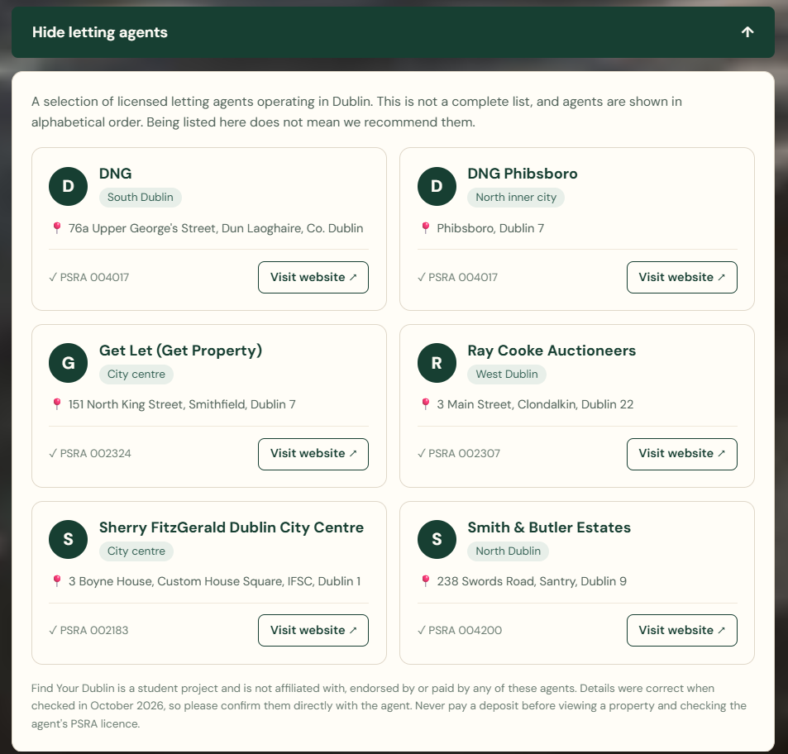
Letting agents mentioned
What's included?
A dropdown under the results opens a list of Dublin letting agents
Each card shows the area, address, website and PSRA license number
Listed alphabetically, not as recommendations
Note that we’re not affiliated, plus a tip to check the licence before paying a deposit
Notes:
The second thing I added is a letting agents section on the results page. Once students see their recommended areas, they can open a list of Dublin letting agents. Each card shows the agent's area, address, website and PSRA licence number, so students can check the agent is licensed.
The list comes from a CSV file, which the backend serves through a new endpoint called /agencies.
I was careful with the wording, because we don't want it to look like we're recommending anyone. The agents are listed alphabetically, there's a note saying we're not affiliated with them, and a tip to check the agent's licence before paying a deposit, since rental scams are a real problem in Dublin.

Slide 20
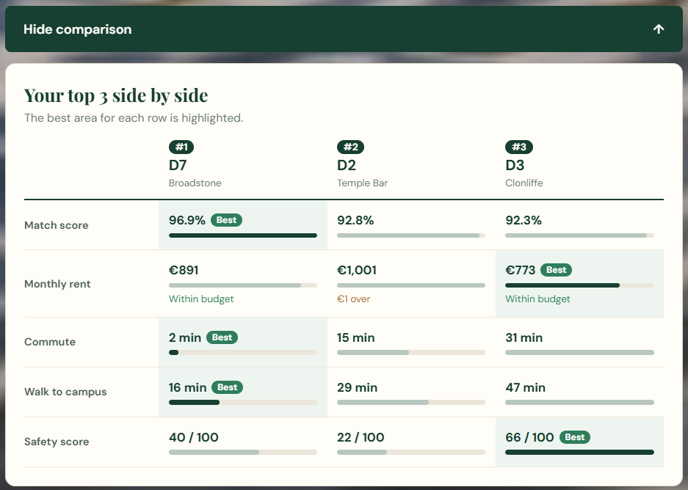
Comparing the results
What it does?
A “Compare these 3 areas” dropdown under the results
Shows match score, rent, commute, walking time and safety for each area
The best area in each row is highlighted, and rent shows if it’s within budget
Notes:
The last feature is a comparison of the top three areas. Before, students had to scroll through three long result cards to compare them. Now there's a "Compare these 3 areas" button that shows them side by side: match score, rent, commute, walking time and safety score.
The best area in each row is highlighted, and the rent row shows whether each area is within the student's budget. It uses data the results already have, so I didn't need to change the backend.
Next, I want to add the new D15 to D24 rent data into the recommender, so these areas can appear in the results too.

